Slide 1

Shell Scripting

Slide 2

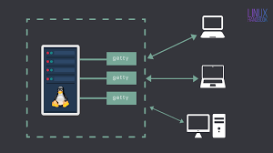
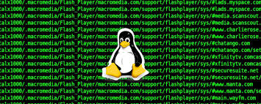
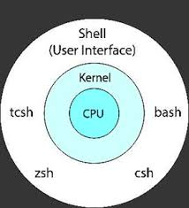
SHELL

Slide 3

A shell is a type of computer program called a command-line interpreter that lets Linux and Unix users control their operating systems with command-line interfaces. Shells allow users to communicate efficiently and directly with their operating systems.

Slide 4
Different types of shells
The Bourne shell is the default shell of the Solaris OS. Despite its age, the Bourne shell is popular today because of its speed and compactness. However, the Bourne shell isn’t very interactive and can’t recall its command history. It also lacks logical and arithmetic expression.
The KornShell runs faster than the C-shell. It runs Bourne shell scripts and features C-like arrays, functions, and string-manipulation facilities. In addition, it features built-in arithmetic.

Slide 5
GNU Bourne-Again shell
The GNU Bourne-Again, or Bash, shell, is an open-source alternative to the Bourne shell. It was designed by Brian Fox for the GNU Project and was released in 1989. Not only is it fully compatible with the Bourne shell, it takes many of the best features from KornShells and C shells. The GNU Bourne-Again shell has automatically mapped arrow keys for editing and command recall.
GNU Bourne-Again prompts include:
Command full-path: /bin/bash
Non-root user default prompt: bash-x.xx$
Root user default: bash-x.xx#

Slide 6

Shell Scripting
A shell script is a text file that contains a sequence of commands for a UNIX-based operating system. It is called a shell script because it combines a sequence of commands, that would otherwise have to be typed into the keyboard one at a time, into a single script.

Slide 7
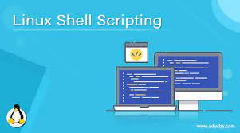
Shell scripting is an important part of process automation in Linux. Scripting helps you write a sequence of commands in a file and then execute them.

Slide 8
Uses of Shell Scripts
Task Automation – It can be used to automate repetitive tasks like regular backups and software installation tasks.
Customization – One can use shell scripts to design its command line environment and easily perform its task as per needs.
File Management – The shell scripts can also be used to manage and manipulate files and directories, such as moving, copying, renaming, or deleting files.

Slide 9
Advantages and disadvantages of shell scripts
Shell scripting is meant to be simple and efficient. It uses the same syntax in the script as it would on the shell command line, removing any interpretation issues. Writing code for a shell script is also faster and requires less of learning curve than other programming languages.
However, if there is an error in a shell script, this can prove to be extremely costly if left unnoticed. Additionally, differing platforms associated with shell scripting may not be compatible. Shell scripts can also be slower to execute than individual commands.

Slide 10
Shell Script Examples in Linux
1) What does the shebang (#!) at the beginning of a shell script indicate?
The shebang (#!) at the beginning of a script indicates the interpreter that should be used to execute the script. It tells the system which shell or interpreter should interpret the script’s commands.
For example: Suppose we have a script named myscript.sh written in the Bash shell:

Slide 11
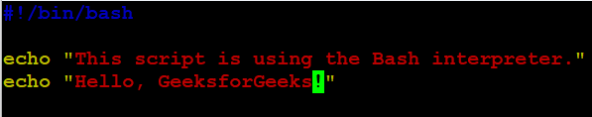
In this example:
The #!/bin/bash at the beginning of the script indicates that the script should be interpreted using the Bash shell.
The echo commands are used to print messages to the terminal.

Slide 12
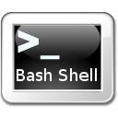
How to execute a shell script in Linux

Slide 13
How do I write and execute a shell script on Linux system?
Steps to execute a shell script in Linux
The procedure is as follows:
Create a new file called demo.sh using a text editor such as nano or vi in Linux:
nano demo.sh

Slide 14
2. Add the following code:
#!/bin/bash echo "Hello World“
3.Set the script executable permission by running chmod command in Linux:
chmod +x demo.sh

Slide 15
4. Execute a shell script in Linux:
./demo.sh

Slide 16
2) How do you run a shell script from the command line?
To run a shell script from the command line, we need to follow these steps:
Make sure the script file has executable permissions using the chmod command:
chmod +x myscript.sh
Execute the script using its filename:
./myscript.sh
Here you have to replace “myscrtipt.sh” with yours script name.

Slide 17

3) Write a shell script that prints “GeeksforGeeks” to the terminal.
The echo command is used to display text or variables on the terminal. It’s commonly used for printing messages, variable values, and generating program output.
In this example we have execute `echo` on terminal directedly , as it works same inside shell script.

Slide 18
Variables are assigned values using the assignment operator =.
For example:
#!/bin/bash
# Assigning a value to a variable
name=”Jayesh”
age=21
echo $name $age

Slide 19
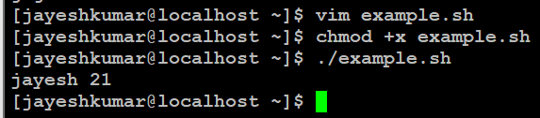
Explanation:
The name variable is assigned the value “Jayesh”.
The age variable is assigned the value 21.
echo is used to print and `$name` `$age` is used to call the value stored in the variables.

Slide 20
6) Write a shell script that takes a user’s name as input and greets them.
Create a script name `example.sh`.
#!/bin/bash
# Ask the user for their name
echo “What’s your name?”
read name
# Greet the user
echo “Hello, $name! Nice to meet you.”

Slide 21
Explanation:
#!/bin/bash: This is the shebang line. It tells the system to use the Bash interpreter to execute the script.
# Ask the user for their name: This is a comment. It provides context about the upcoming code. Comments are ignored by the interpreter. echo “What’s your name?”: The echo command is used to display the text in double quotes on the terminal.
read name: The read command waits for the user to input text and stores it in the variable name.
echo “Hello, $name! Nice to meet you.”: This line uses the echo command to print a greeting message that includes the value of the name variable, which was collected from the user’s input.

Slide 22
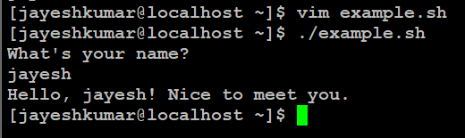

Slide 23
Automating system administration tasks

